Slide 1
TRANSITS Group Exercise
Based on ENISA Exercise 11“Incident Handling in Live Role Playing”
Place
Date

Slide 2
Roleplay Rules
In this game, you and your table will play as one character.
Read your character card and ask your tutor any questions you may have.
Alice will start by making a phone call to one of the other characters in the room.
After each call the receiver must decide on an action in the form of a communication to another player (call, email, meeting).
You cannot use any information that you did not receive from another player.
We will keep going until the incident is resolved or the tutors decide to end.
When we are finished, you will be asked for feedback on how the incident was managed.

Slide 3


Rulers of Time
The Rulers of Time
(and supporting actors)
for this exercise:
the Tutors
They know all, see all and can pause / fast forward / reverse time.
Photo Andrik Langfield on Unsplash

Slide 4

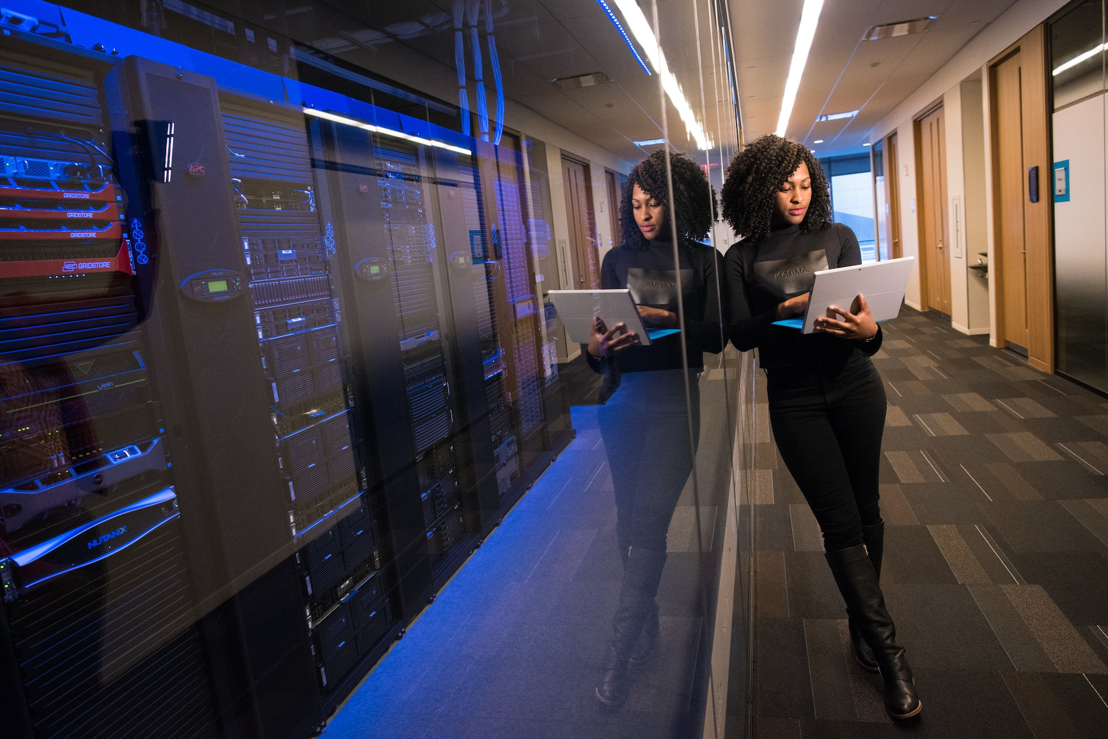
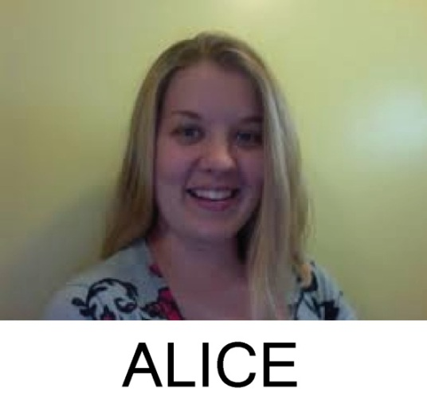
Alice
A talented young (and underpaid) designer.
Not very happy at Ads-R-Us, and she has been looking for work for a while.
Today, Saturday morning, she received an email from a potential employer, with a PDF attachment describing the position, but when she opened it, it appeared to be empty.
Photo by Christina @ wocintechchat.com on Unsplash

Slide 5
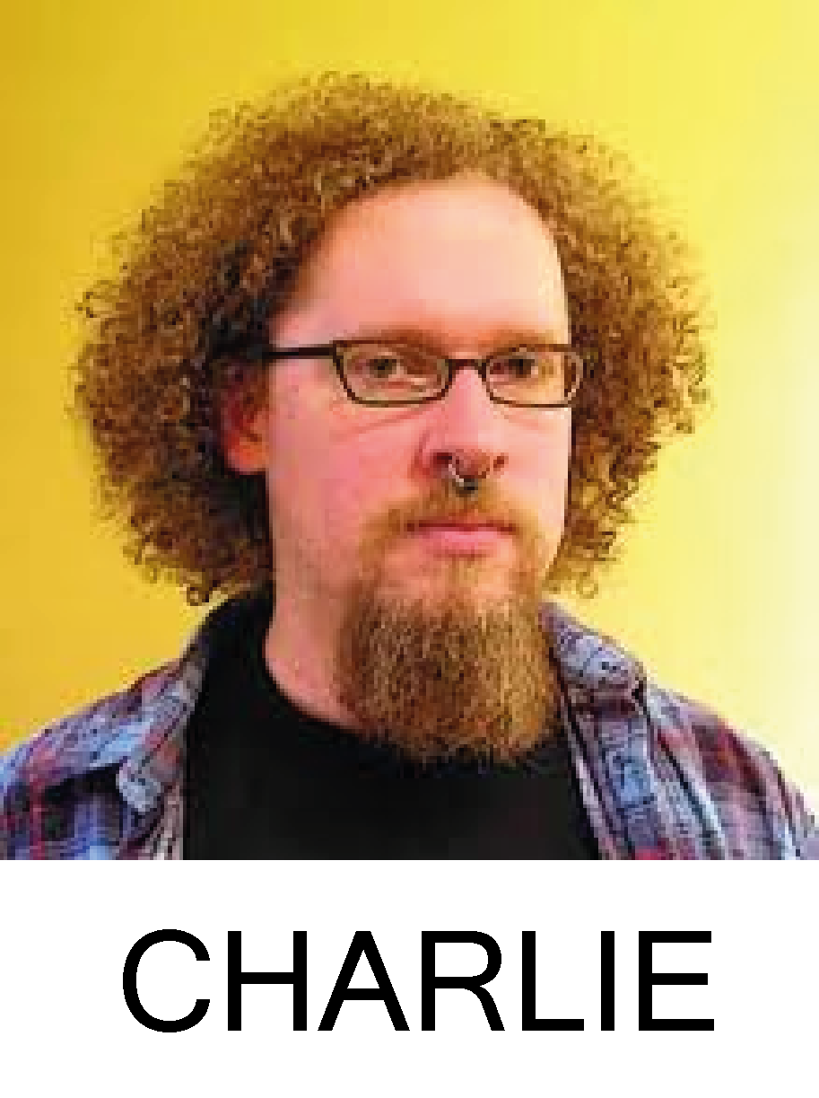
Charlie
Network engineer
Set-up VPN to allow secure remote working
Is on duty today to provide general support
He is responsible for the company network.
He doesn’t really understand why Ads-R-Us
needs a CSIRT function, but thinks that
ERNEST is a pretty good guy all the same.

Slide 6

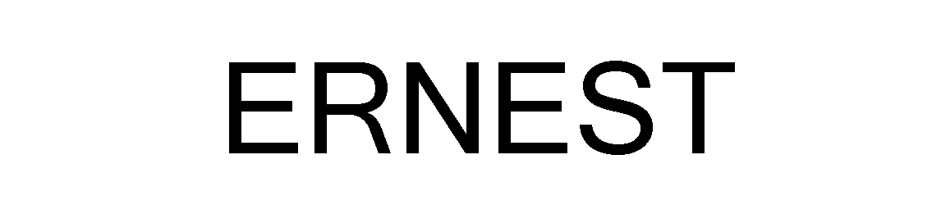
Ernest
Network administrator and IT Support
Part-time CSIRT Officer
He is responsible for the company
network and software, including the
security stuff and he has regular
contact with Big-ISP and the software
vendors who provide services to
Ads-R-Us.
Photo by Desola Lanre-Ologun on Unsplash

Slide 7
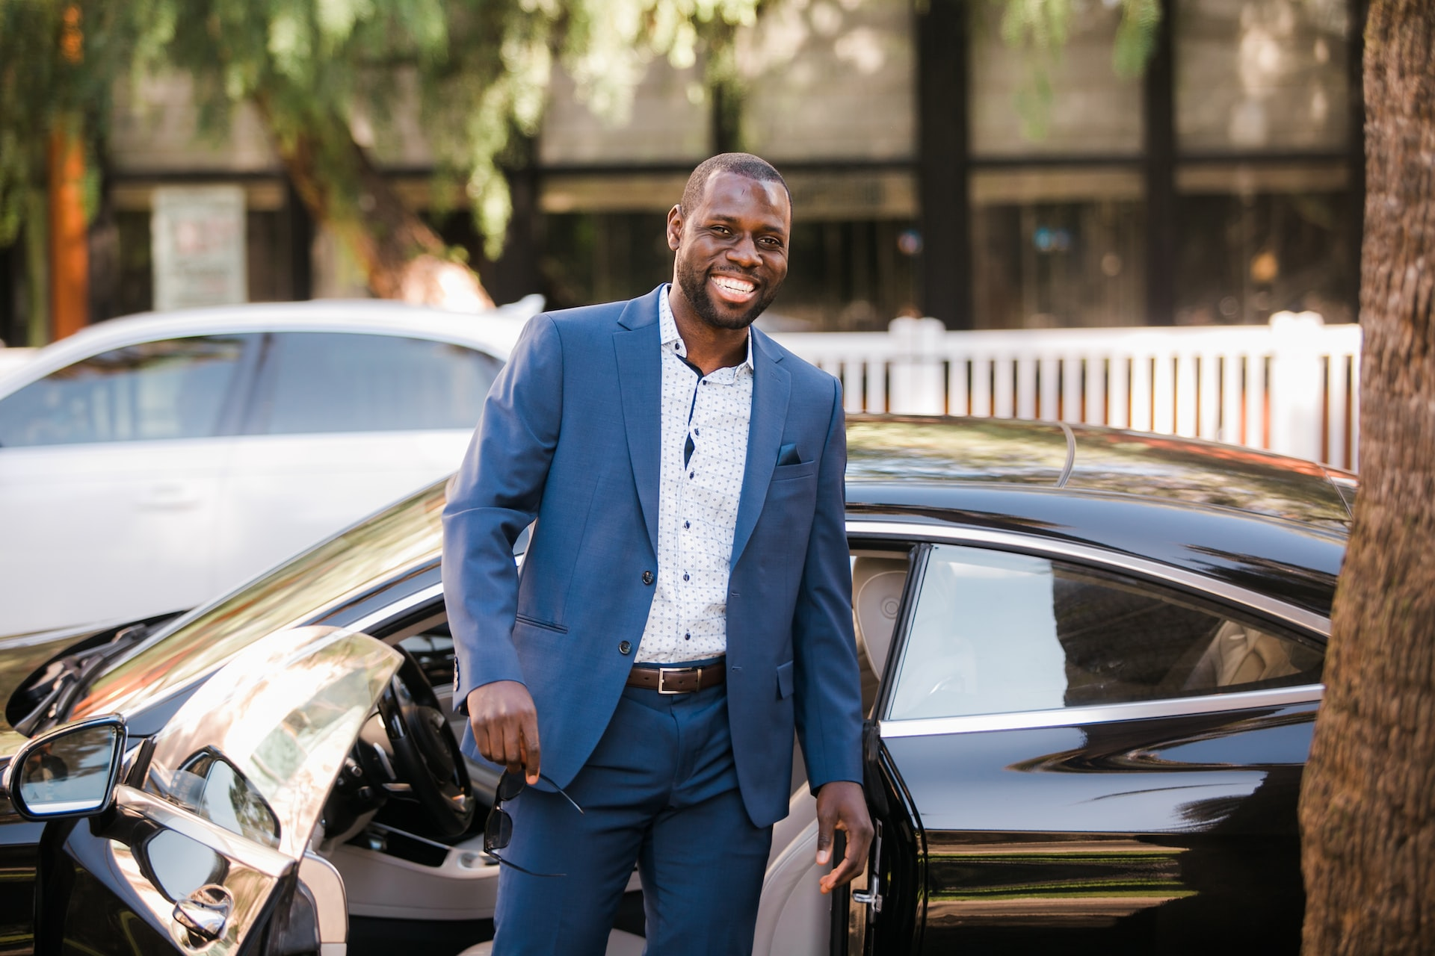
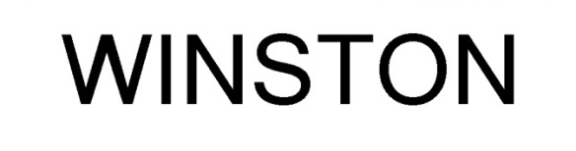
Winston
CEO of Ads-R-Us
A little stressed about the company finances
Delegation is his key management skill
He is looking forward to a meeting with
a big client on Monday for a new
campaign, which he has been told
will be ready in time.
Right now he is relaxing at home, as
its his daughter’s birthday.
Photo by Fortune Vieyra on Unsplash

Slide 8
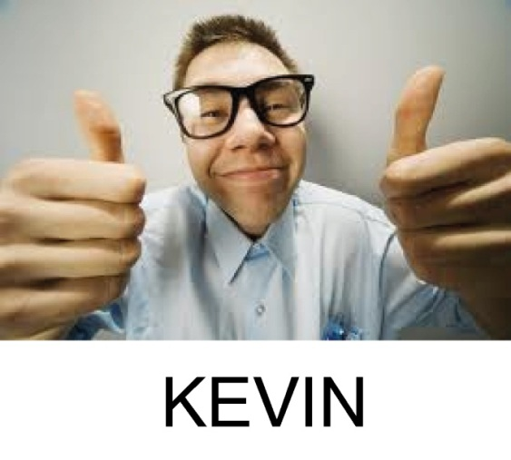
Kevin
Keen IT student
Loves tinkering with computers
Into computer security
He believes in ethical hacking, and often finds security flaws in software. He also believes strongly that commercial companies should be generous to helpful testers like him.

Slide 9

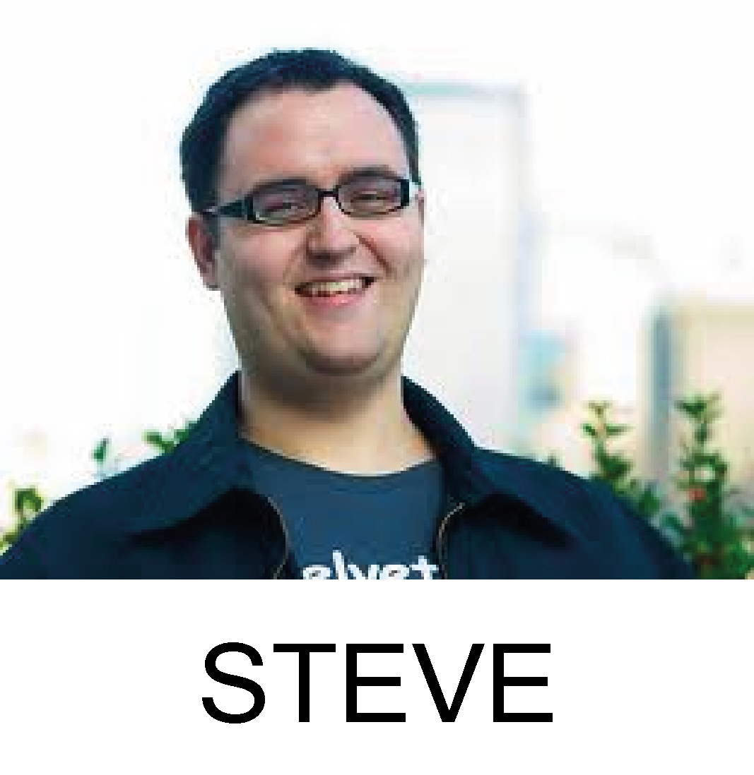
Steve
Head developer at MUNIX
Ads-R-Us uses MUNIX as their group working tool
Is aware of some bugs, and is working to fix them
He recently took a phone call from some guy asking
for a lot of money to tell him about a bug he’d found.
He offered the guy credit in the security advisory, but
the guy just laughed and hung up. He looked into it
and found the bug, but decided to keep it quiet until
he had written a patch.

Slide 10

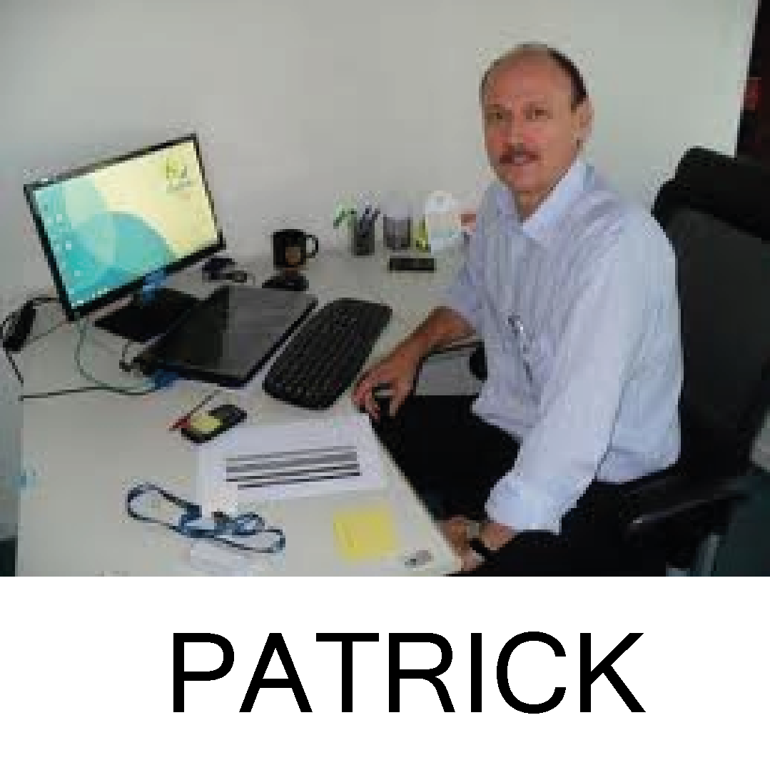
Patrick
CSIRT Officer in the biggest ISP in the country
On duty today
BIG-ISP supplies the internet connection to Ads-R-Us and the majority of users in the country.
He met ERNEST once at a TF-CSIRT
meeting, exchanged PGP keys,
and has regular contact with him
professionally.

Slide 11
Scenario
It is Saturday morning, and Alice is working remotely on an important project which is due on Monday. She is trying to access some files on the company server over VPN. She can access the server alright, but the files she left there on Friday evening are missing. So she calls the company helpline.
The administrator on duty (Charlie) will discover that somebody had accessed the server from Alice’s account last night and apparently erased the project files of all the users from the file server.
Since Alice’s account is a regular user account without sufficient privileges to access or modify another user’s data, there seems to be something seriously wrong...

Slide 12

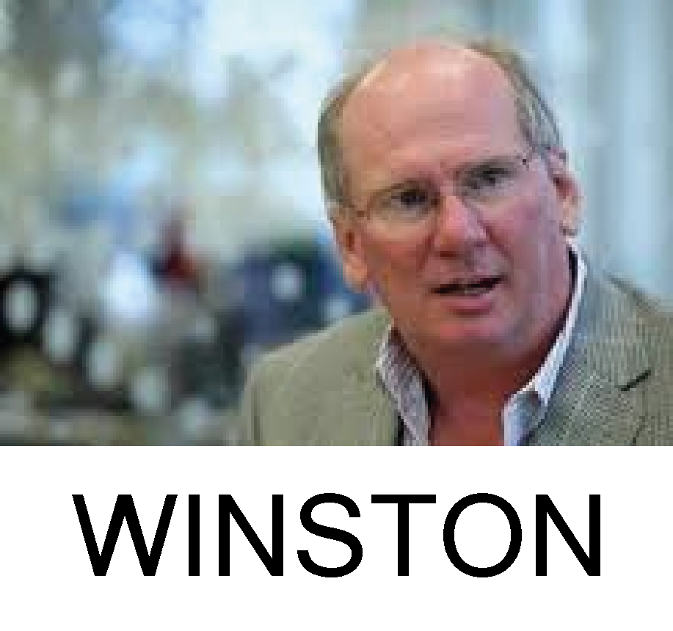

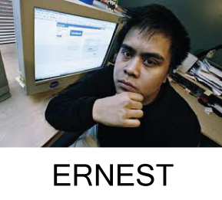
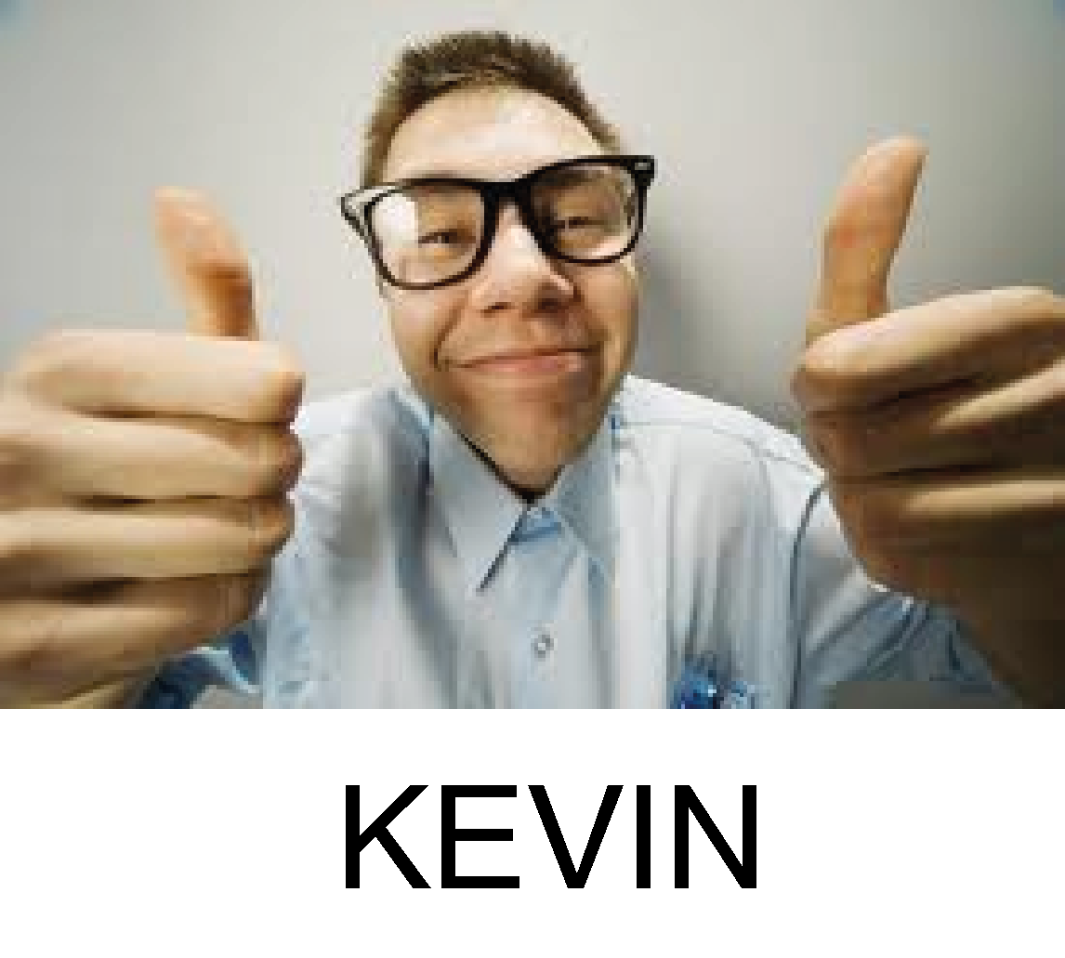

The Players
CEO
Software
developer
Network Engineer
Sys. Admin
CSIRT
CSIRT
Officer
Junior
Designer
Student

Slide 13
3, 2, 1 - Let the exercise begin …

